Slide 1
Who’d Want to be a Treasurer
Derek Harwood, National Treasurer
Rev 02 February 2024

Slide 2
  Agenda: 10.40 to 11.35 (55 mins)
  What does the national Treasurer do? 10mins
  What support is available for you? 10mins
  Where does our Subscription money go? 15mins
  Changes on Grants 10mins
  Questions as we go

Slide 3
1. What does the national Treasurer do?
10.40

Slide 4
Or what does Derek Harwood do?
  Trust Treasurer (10%)
  TATTL Treasurer (10%)
  Trustee of both (~80%)
Do you want to Volunteer?

Slide 5
  What does the national Treasurer do? This is the official role description:
  • Ensuring the Board is kept fully informed about its financial duties and responsibilities.
  • Presenting the Board with budgets, accounts and financial statements as required.
  • Ensuring the financial resources of the charity meet its present and future needs.
  • Ensuring the charity has appropriate reserves and investment policies.
  • Overseeing that there are appropriate accounting procedures and controls in place.
  • With the CEO liaising with any paid staff and volunteers about financial matters.
  • Advising on the financial implications of the organisation’s strategic plans.
  • Monitoring the organisation’s investment activity and ensuring it is consistent with the organisation’s policies and legal responsibilities.
  • Ensuring that the accounts are prepared and disclosed in the form required by funders and the relevant statutory bodies, for example the Charity Commission and the Registrar of Companies.
  • Ensuring that the accounts are audited in the manner required and any recommendations are implemented.
  • Making a formal presentation of the accounts at the annual general meeting and drawing attention to important points in a coherent and easily understandable way.
  • Sitting on appraisal, recruitment and disciplinary panels as required.

Slide 6
  In summary:
  • Ensuring the Board is kept fully informed about its financial duties (inc presenting the Board with budgets & regular accounts).
  • Ensuring the financial resources of the charity meet its present and future needs (inc reserves & future plans)
  • Overseeing that there are appropriate accounting procedures and controls are in place.
  • Ensuring that the accounts are prepared in the form required for statutory submissions.
  • Ensuring that the accounts are audited.
  • Present the accounts at the AGM.
  &
  Provide advice to the u3as (by various means): next section

Slide 7
  New and extra:
  • Assist with supply of financial communications
  • This has included: provision of quarterly ‘Finance News Extra’
  • Provision of a Half Year report and an End of Year report
  Has it worked? Do you feel adequately informed?

Slide 8
2. What support is available for you?
10.50

Slide 9
  Current Advice Methods:
  By the national Website (documents)
  By the u3a Office help line (email or phone)
  By email direct to me (treasurer@u3a.org.uk)
  By national workshops

Slide 10
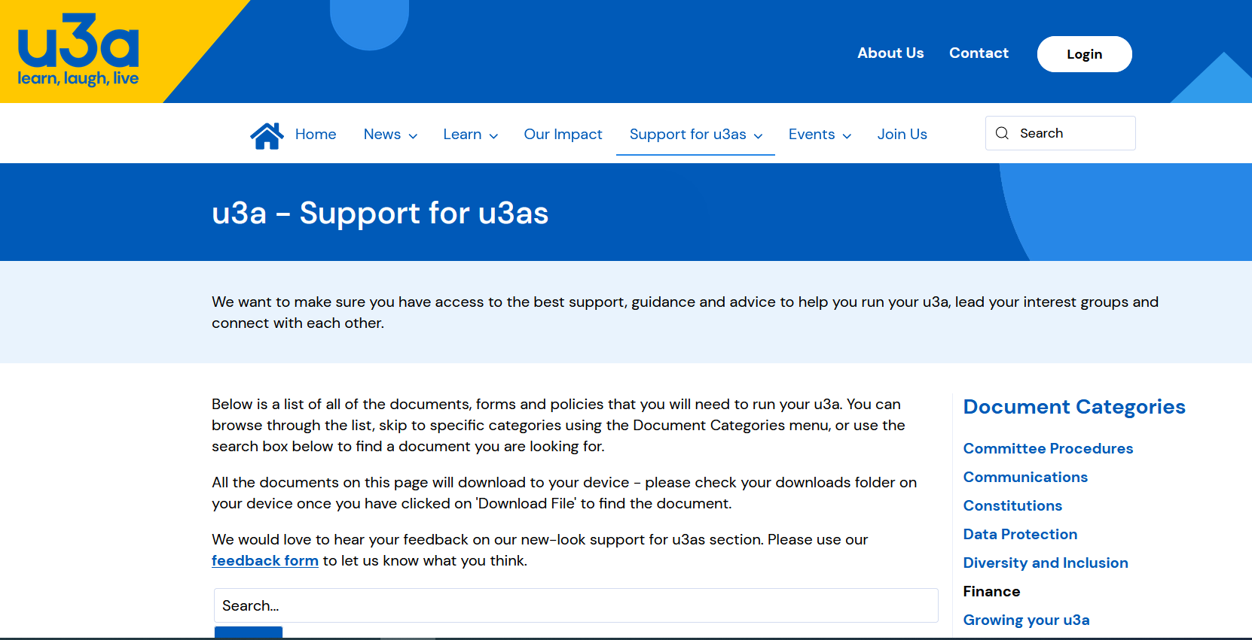
  Advice:
  • Through the website:

Slide 11
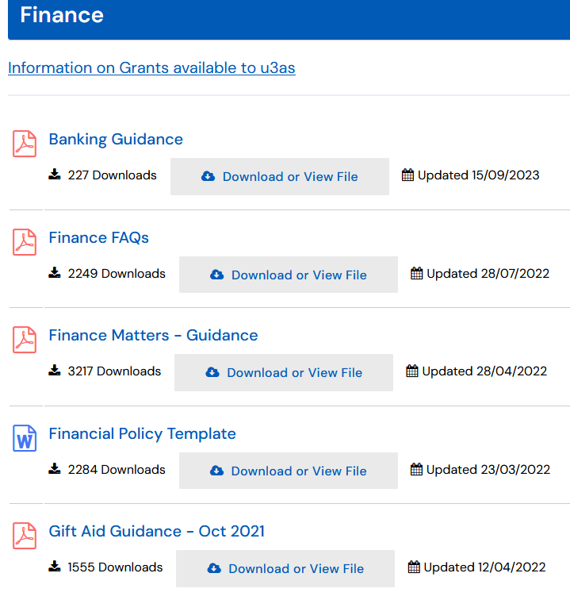
  Six key ‘Finance’ documents available
  (Banking is a new one):
  Anything else required?

Slide 12
  2. By the help line, per month, total requests for support are:
  +1,000 telephone queries
  +850 email enquires
  Not just finance, split not known
  3. By national workshops:
  Generally held 3 times a year

Slide 13
  Is that enough?
  What else would you like?
  For example:
    More guidance documents?
    A national or regional ‘Peer Support Group’?
    Others?

Slide 14
4. Where does my Subscription money go?
11.00

Slide 15
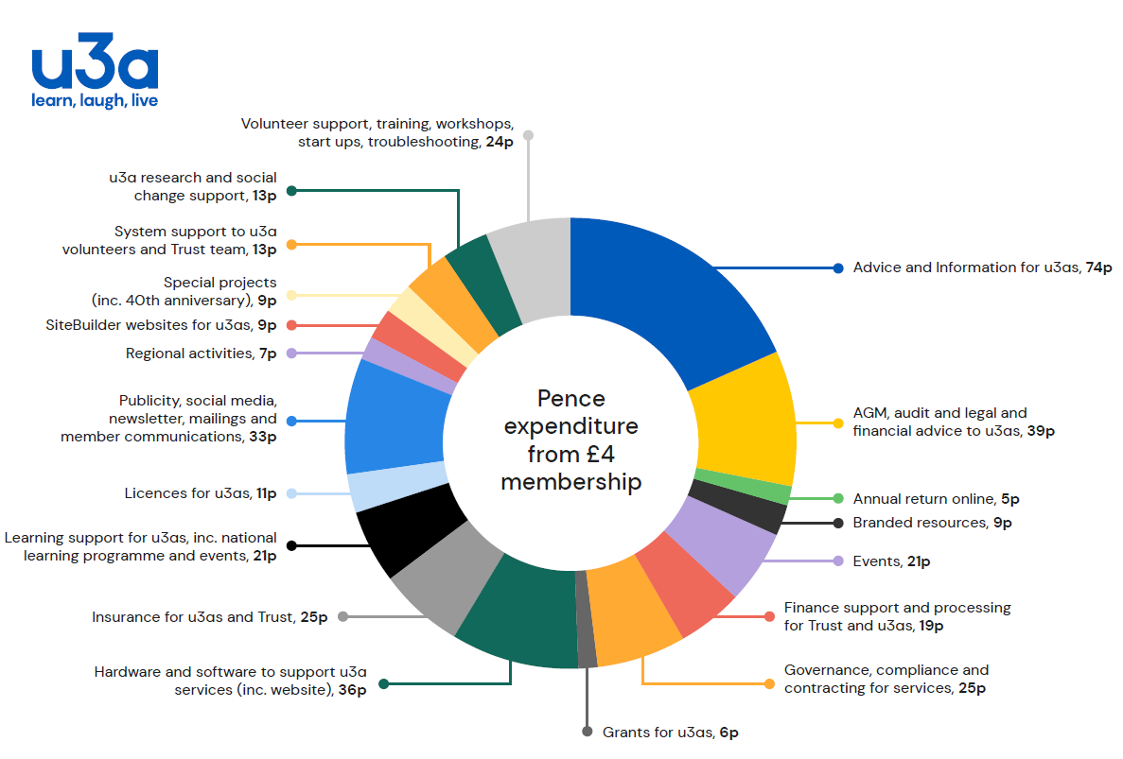
Breakdown and analysis:

Slide 16
SERVICE TYPE
Advice and Information for u3as, | 18.5%
AGM, audit and legal and financial advice, | 9.8%
Hardware and software to support u3a services (inc. website), | 9.0%
Publicity, social media, newsletter, mailings and member communications, | 8.3%
Insurance for u3as and Trust, | 6.3%
Governance, compliance and contracting for services, | 6.3%
Volunteer support, training, workshops, start ups, troubleshooting, | 6.0%
Learning support for u3as, inc. national learning programme, | 5.3%
Events, | 5.3%
Finance support and processing for Trust and u3as, | 4.8%
u3a research and social change support, | 3.3%
System support to u3a volunteers and Trust team, | 3.3%
Licences for u3as, | 2.8%
Grants for u3as, | 1.5%
SiteBuilder websites for u3as, (support to TATTL) | 2.3%
Regional activities, | 1.8%
Annual return online, | 1.3%
Others | 4.8%
 | 100.0%
Breakdown as %age:
* Above includes support to TATTL Services.

Slide 17
What’s not included:
Development Projects.
These are currently funded by drawdown on our reserves.

Slide 18
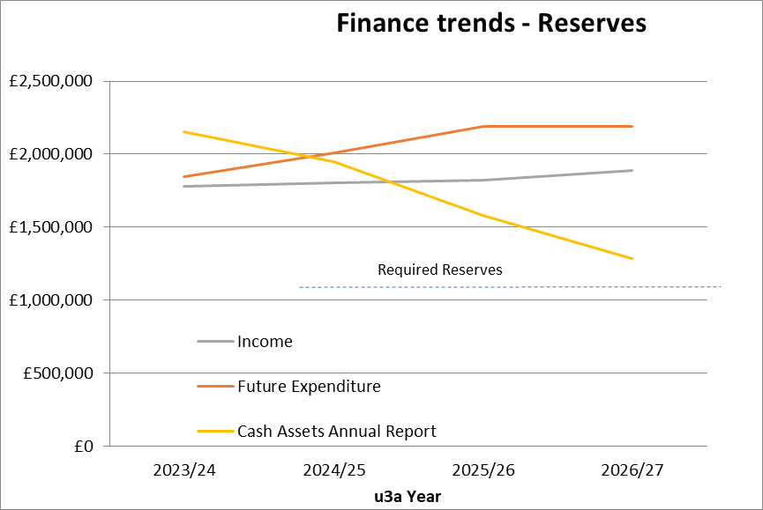
Reserves drawdown:

Slide 19
Future possibilities:
Less expenditure (on eg Development)
More forms of income (Grants, Donations, Legacies)
Other forms of charging
Membership subscription increase

Slide 20
5. Changes to Grants
11.15

Slide 21
Why Change?
We’ve been underspending on the Grants budget, not enough take up.

Slide 22
Grant types available for 2024/25:
Start Up grants | £300 | direct
Start Up grants publicity packs | £200 | direct
Update Publicity | £100 | via RT
Interest Events Grant | £500 | via RT
Large National | £5,000 | via Office
Large National | £2,500 | via Office
Large National | £1,000 | via Office

Slide 23
Any other questions?
u3a
  156 Blackfriars Road
  London, UK
  SE1 8EN
Contact the National Office
  Tel: 020 8466 6139
  Email: info@u3a.org.uk
  u3a.org.uk
  twitter.com/u3a_uk
  facebook.com/u3auk

